Slide 1



CINEA/EMFAF/2021/3.1.2/03/SC04/SI2.881222
Specific Contract 2021/3.1.2/03/SC04
Hosting, maintenance and further development of the Regional Database for the Mediterranean and Black Seas
Statistical Workshop
“Common raising procedures for processing
the Med&BS biological data”
16th of January 2025

Slide 2

RDBFIS Statistical Workshop
to better understand the existing statistical systems and to make available (through the RCG and RDBFIS websites) the raising procedures for processing the Med&BS biological data
Scope of Statistical Workshop
to compile the background information on the raising procedures of the involved MSs
to explore the possibility of optimizing /adapting (if needed) the most commonly used methodology so that it can serve as a recommended option to be followed by the MSs of the Med and Black Sea through the RDBFIS.
Together with the Med&BS Steering Committee of RDB
Approved by the RCG Med&BS

Slide 3
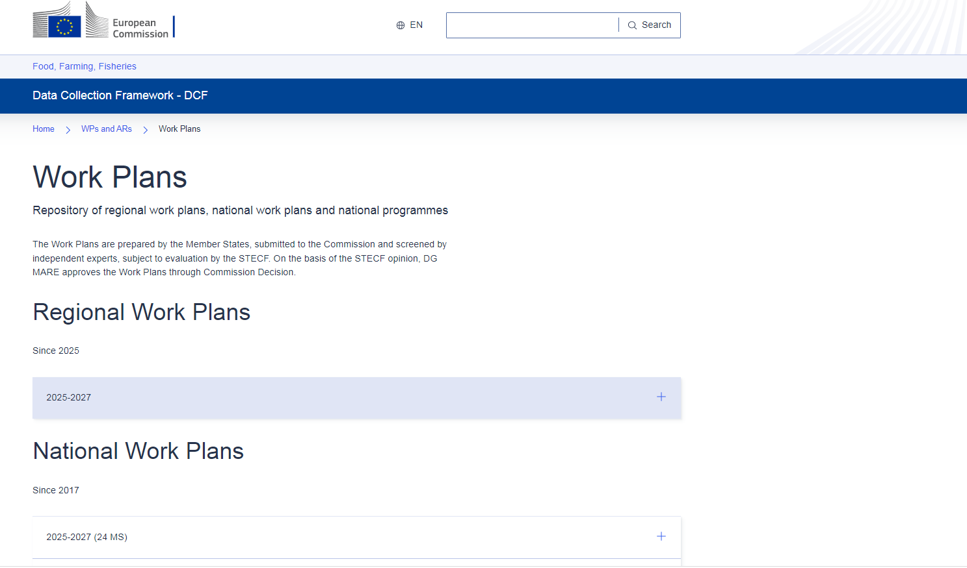
Work Plans

Slide 4
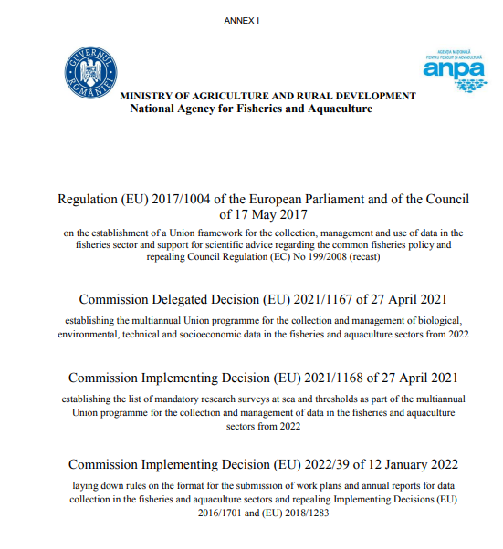


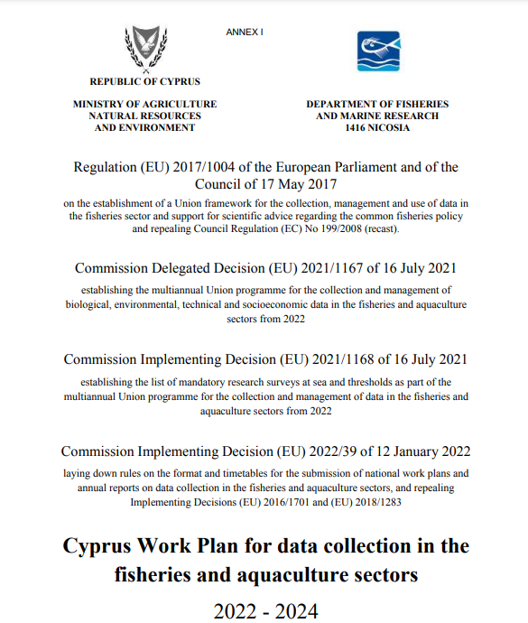
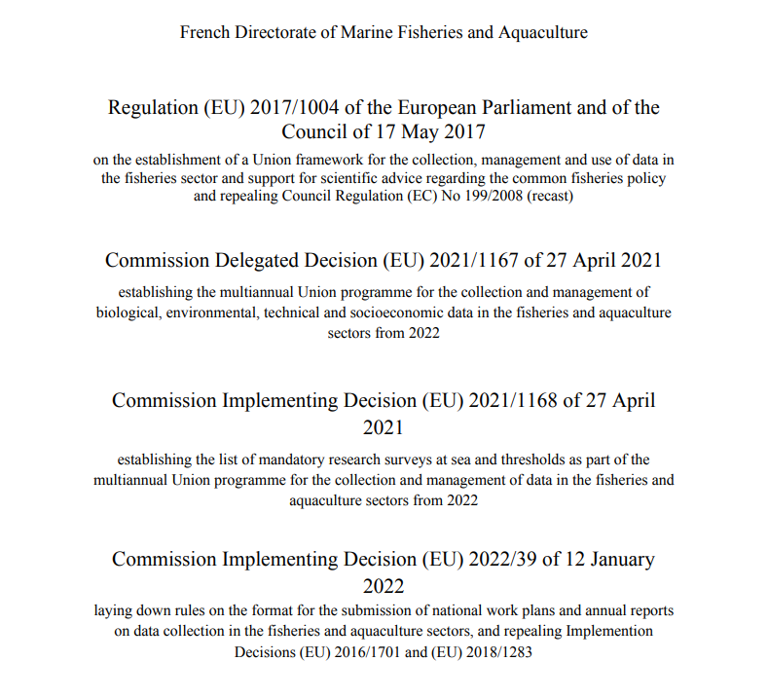

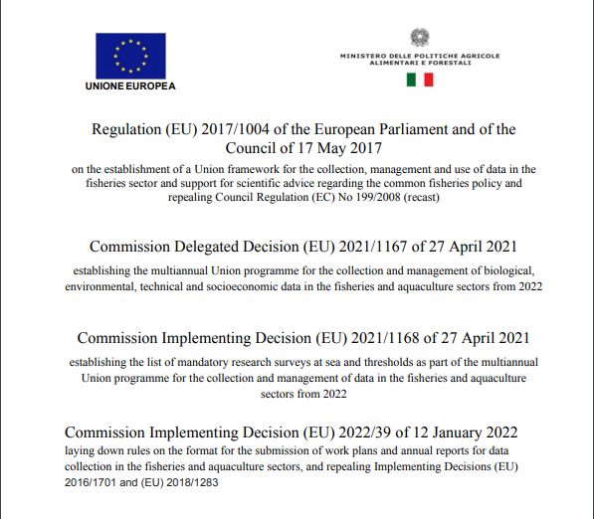

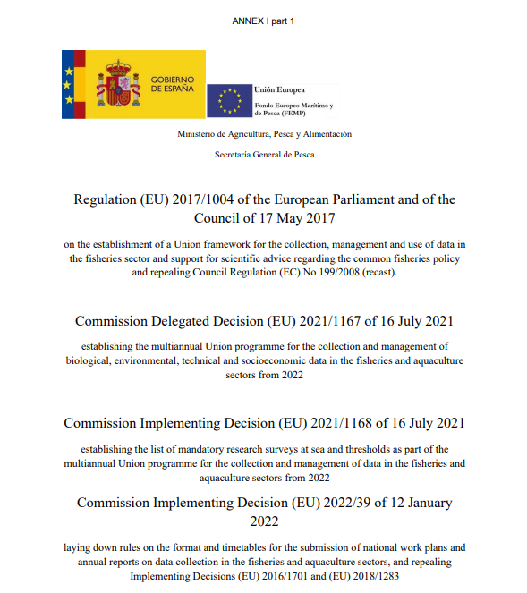

Work Plans

Slide 5
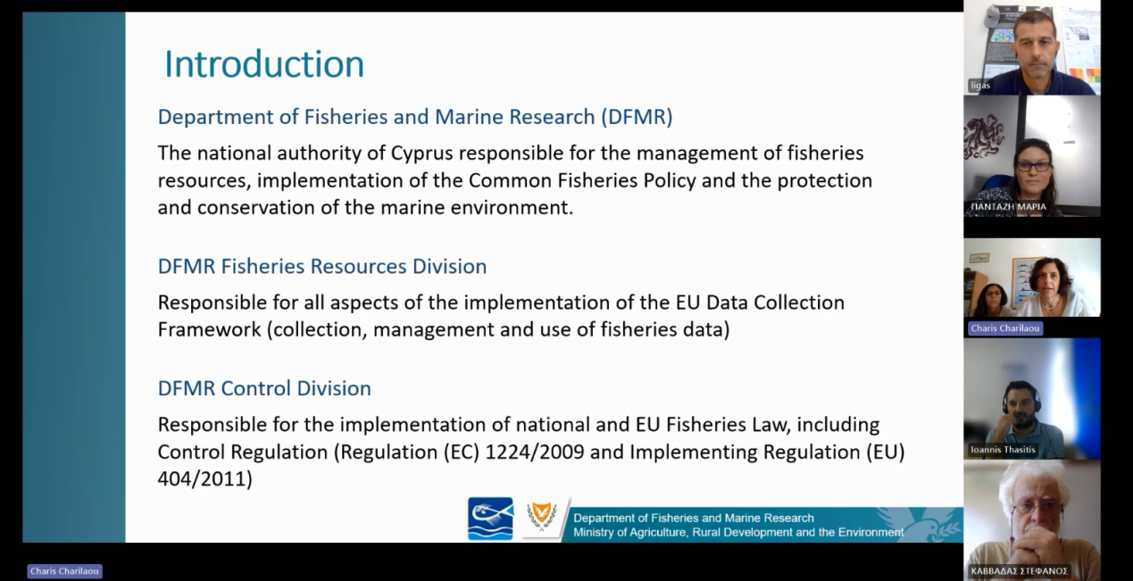

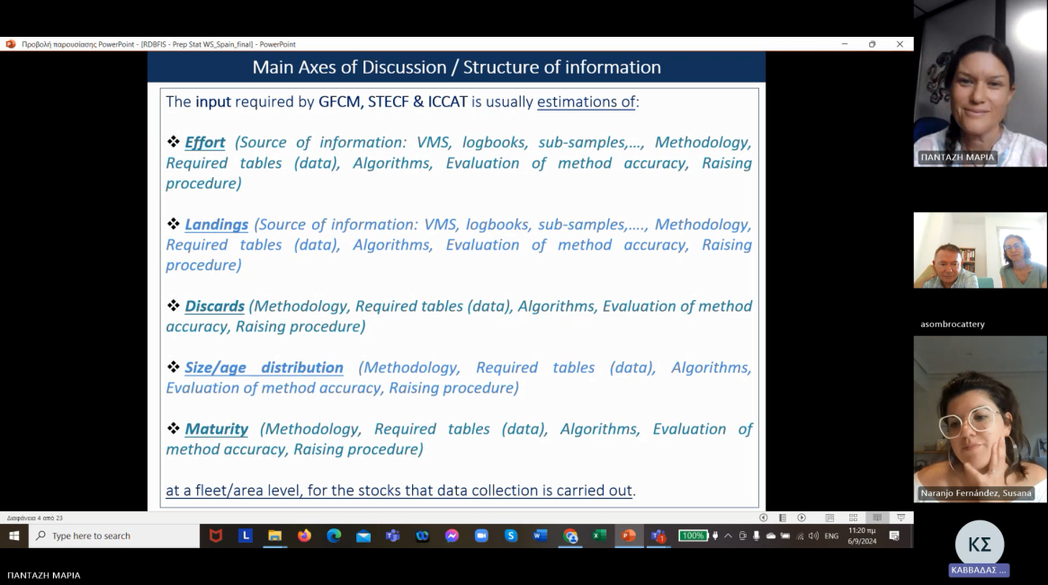
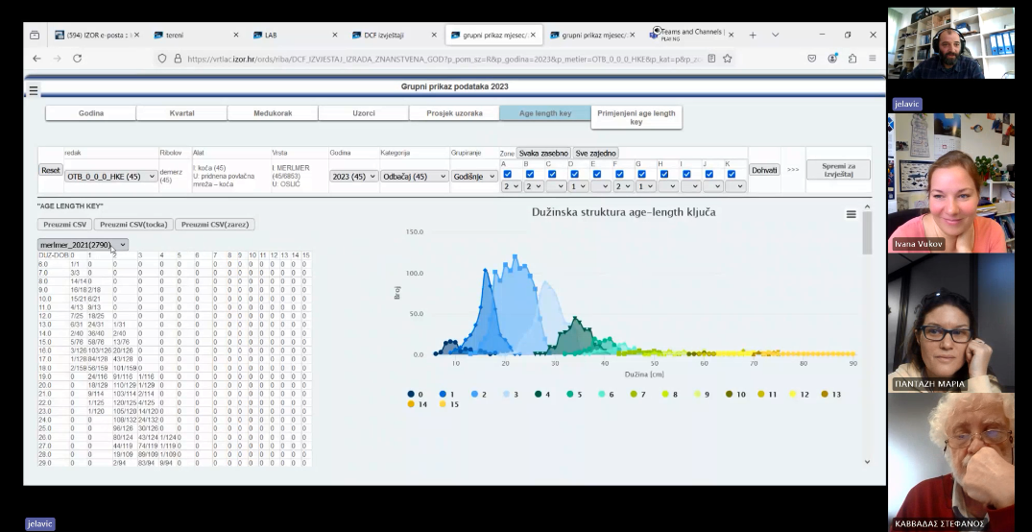
Bilateral Meetings

Slide 6

Main Axes of Discussion / Structure of information
Discards
Size/Age Distribution
Source of information
Maturity
Source of information
Source of information
Methodology
Data
Algorithms
Accuracy
Raising Procedure
Methodology
Data
Algorithms
Accuracy
Raising Procedure
Methodology
Data
Algorithms
Accuracy
Raising Procedure
BILATERAL MEETINGS

Slide 7
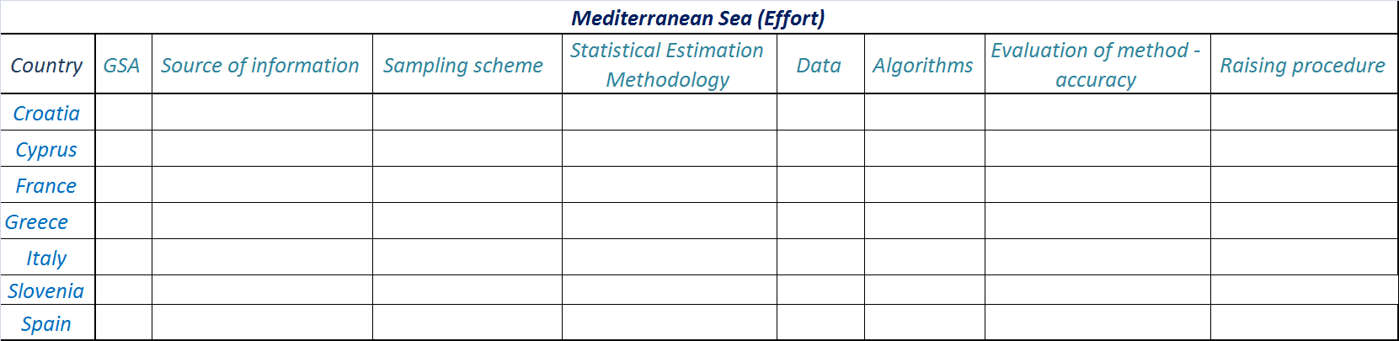
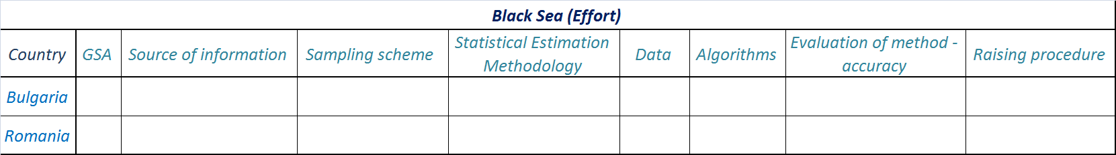
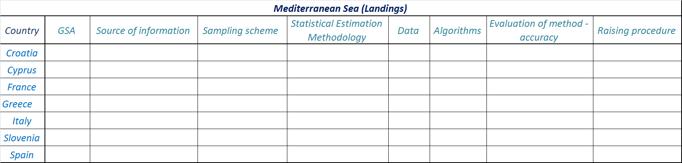
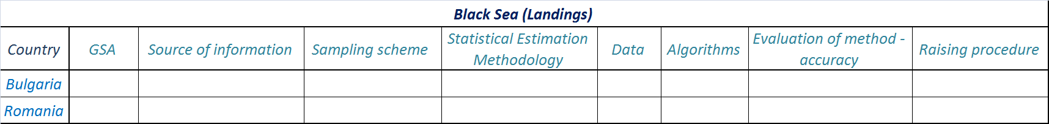
Structure of information / Excel Tables

Slide 8
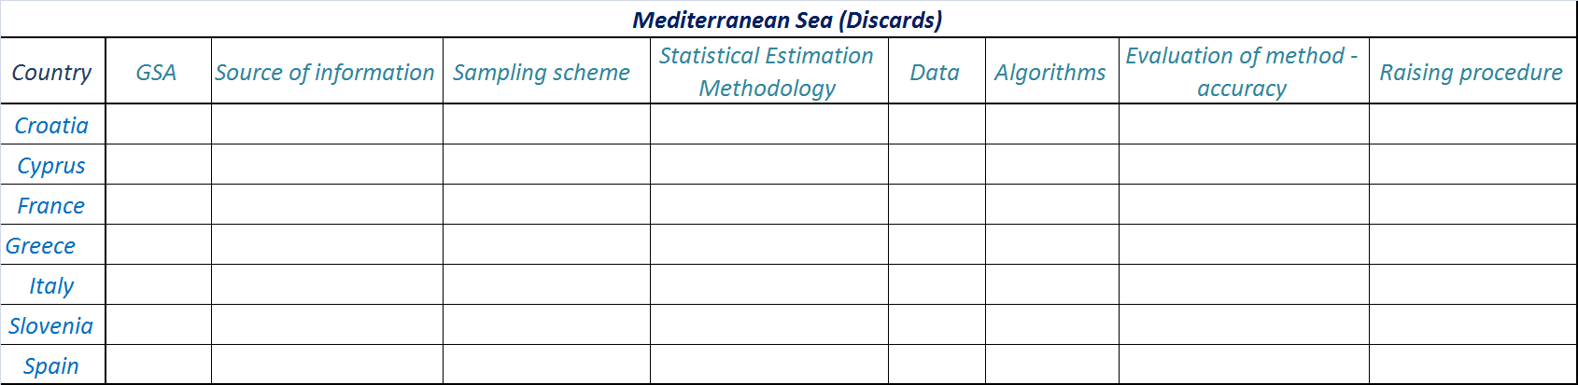
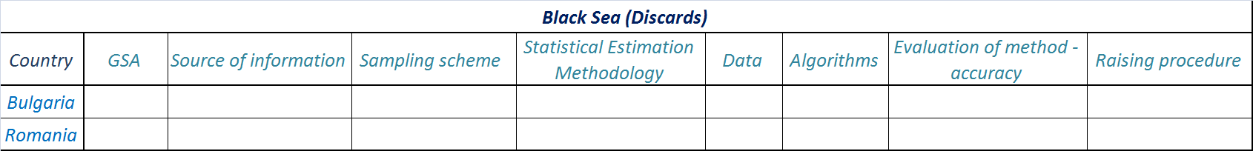
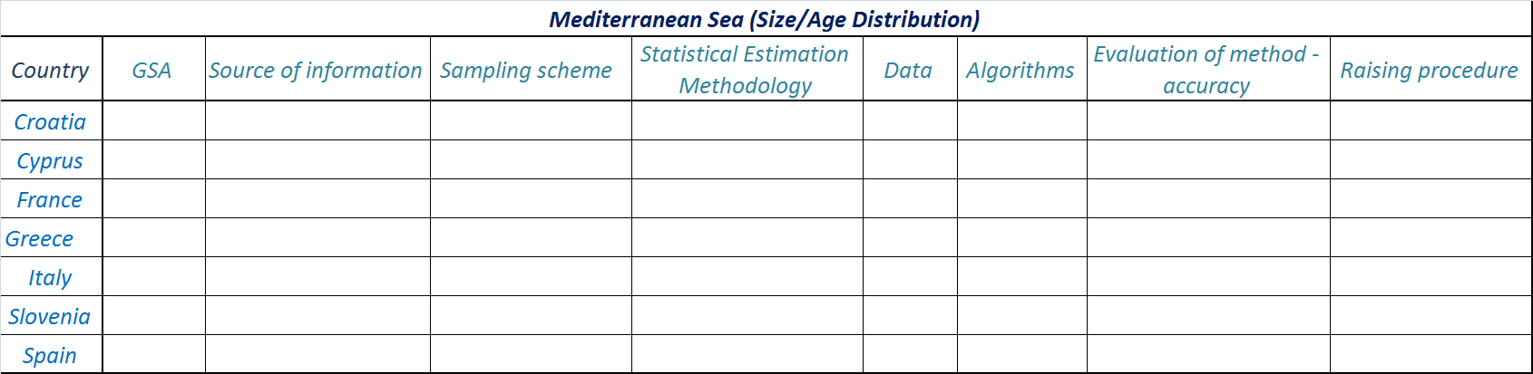
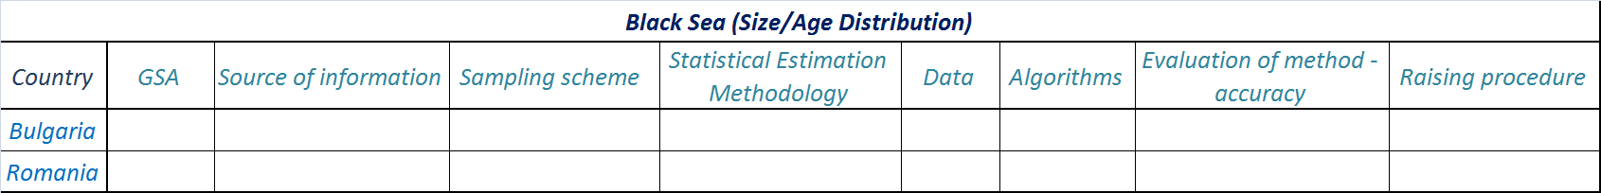
Structure of information / Excel Tables

Slide 9
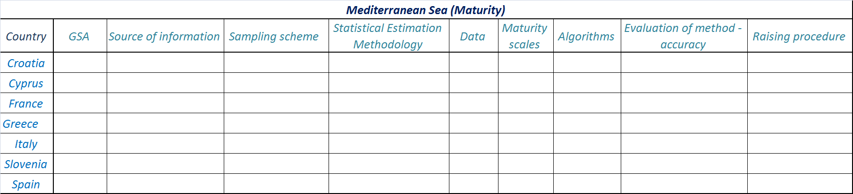

Structure of information / Excel Tables
Greek “Case Study” Example

Slide 10
Overall Highlights of Bilateral Meetings
General
❍ Through the bilateral meetings & the RDBFIS workshop, the attempt made to coordinate and streamline the harmonization of the different raising procedures followed, is of high importance for each of the MSs & should also be a point of discussion in the RCG
❍ Estimation of other biological variables required by DCF: maturity ogive, sex ratio, VBGF should be discussed at RCG Med&BS level
❍ Dynamic application for the commercial fisheries in order to facilitate the MED&BS reporting obligations (including data entry, quality control checks, raising procedures, reports for each “metier” as well as metadata information)
❍ The term “metier” refers to the level of the national gear, therefore the raising procedures followed are specific to the national gears and to the species. It is important for MS to keep the raising to the level of the national gear since this coincides with the level of management (important for stock assessments). The geographical national level followed, is important because it corresponds to the management units, and the sampling is also designed according to it

Slide 11
Overall Highlights of Bilateral Meetings
Effort & Landings
❖ Sampling survey for registered vessels < 10m
❖ Effort and Landings data are collected based on the official documents: landings and fishing reports on the basis of the entire fleet (census data); therefore no raising procedures are applied on them
❖ MS does not perform any kind of raising: the total landings are provided by the sales’ notes and the landings of each species are allocated to the different gears
❖ Tracking data: in some MS all vessels are being tracked using GPRS (vessels >12m have VMS), so there is the possibility to compute the effort for all the fleet, but this cannot be done yet because there is not an automated system in place at the moment. GPRS provides the same type of information as VMS. The logbooks include information on number of trips and number of days and depending on the metier, a fishing trip does not necessarily equals to a fishing day.

Slide 12
Overall Highlights of Bilateral Meetings
Discards
❖ Although fishermen are expected to report discards, this information is usually rare. Therefore the information on discards is collected by the on-board sampling observations which is then raised to the fleet. Same methodology as for landings
❖ The discard ratio is calculated based on the 2019 GFCM manual “Monitoring discards in the Mediterranean and Black Sea fisheries”; the ratio estimator of discards is estimated by dividing the discarded amount of the species in the stratum by the amount of all the retained commercial species
❖ Regarding Discards data, the MS follows two different approaches: (i) data based on official reports and (ii) scientific estimation of discards based on the sampling program
❖ Estimate the total discards of the fleet in weight and number for each species, according to the chosen time unit (Year or Quarter) and for each Fishing Unit or Metier. To do this, the MS uses different raising methods (effort, landing and landing of target species) defined in the Workshop on Discard Raising Procedures (ICES, 2007). In the case of the Mediterranean, discards are estimated with the fishing effort.

Slide 13
Overall Highlights of Bilateral Meetings
Age / Size Distribution & Maturity
❖ Age-length key is calculated and then the age-length key is raised according to the landings. Same methodology is applied as landings. No raising is applied for age.
❖ Same method as in Greece for the species with otolith age reading, as it is described in the slice 20. R scripts (not otolith reading) are used to run slicing methods in order to obtain the number at age distribution out of the raised length frequency distribution.
❖ For the Size/Age distribution data & Maturity data, the raising procedures followed are developed by the national institutes, and based on the landings and catch data, they are raised to the totals. There are some exceptions due to the fact that official data sometimes are not gender based and the data coming from the sampling are on species level, therefore certain recalculations are needed in order to harmonize them.
❖ R package developed to estimate uncertainty of some biological parameters: growth, maturity, sex-ratio and length-weight curves.
❖ Based on the L50. MS follows the FAO guidelines which are similar to MEDITS. Same methodology as for landings

Slide 14
Way Forward / New Service
New Service
Activity 9: Common raising procedures for the Med&BS biological data
Build upon the work already done
In close liaise with MSs’ representatives, regional experts and Med&BS Steering Committee of RDB
The suggested approach needs to be approved by the RCG Med&BS before it comes into service

Slide 15

Thank you!
Maria Pantazi (mpantazi@hcmr.gr)
Stefanos Kavadas (stefanos@hcmr.gr)_

